Slide 1

currency converter
Convert Easily

Slide 2

Table of contents
Introduction
Algorithm
Flowchart
Designing
Outputs

Slide 3

Currency converter
Currency converter is a tool used to convert one country’s currency to another.

Slide 4

Algorithm
Step1: Start
Step2: Enter the amount value
Step3: Select the currency from and to
Step4: Click on the covert button
Step5: The value will be displayed
Step6: Exit

Slide 5
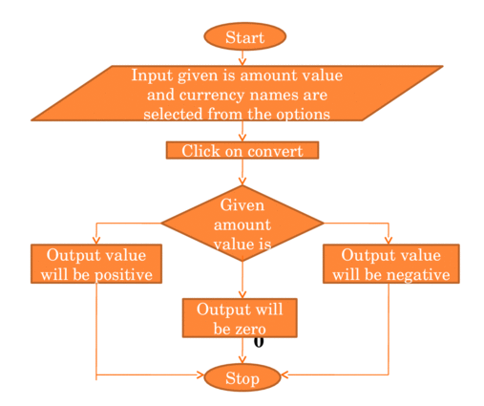
Flow Chart

Slide 6
Designing
We are using different concept like
HTML for creating web page
CSS for using colors, layout, and fonts.
JavaScript for it is mainly used for validation purposes.
This code is implemented by using browser.

Slide 7
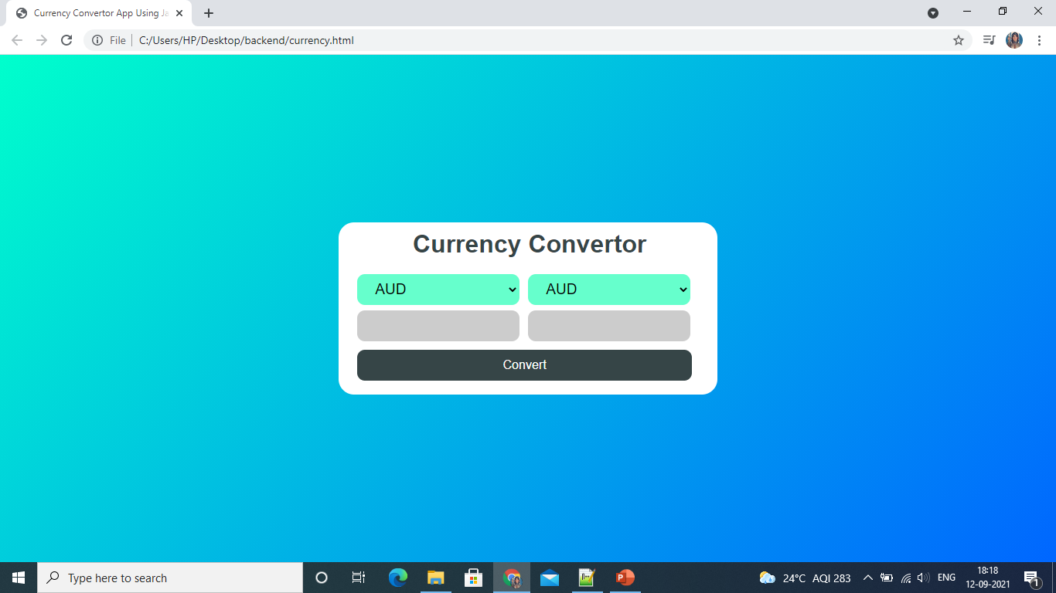

Slide 8


Slide 9

Thank you!
psdoke99@gmail.com
https://github.com/pratikshadoke99/currency-convertor

